Slide 1
Prioritization Activity Timeline
PEPFAR bridge allocations provided
Release of MoU
GF shares revised budget envelopes
GF grant revisions complete
June 2025
July 2025
Aug 2025
Sept 2025
Oct 2025
Nov 2025
CQUIN/HIVE strategic planning meeting
CQUIN annual meeting
Country Scenario Prioritization Discussions
Revised Country Prioritization based on epidemiology & budget
Notes:
This timeline incorporates GF, USG plans as well as CQUIN and HIVE upcoming activities to ensure alignment across the network.
End of Meeting Deliverables:
Initial draft of prioritized HIV services
Initial draft of minimum set of indicators aligned with the prioritized HIV services
Countries to develop next steps for the mid-July deliverables
By Mid-July countries will have:
Refined prioritized HIV services and indicators
Developed country action plans
CQUIN Annual Meeting in November:
Countries will update action plan progress

Slide 2
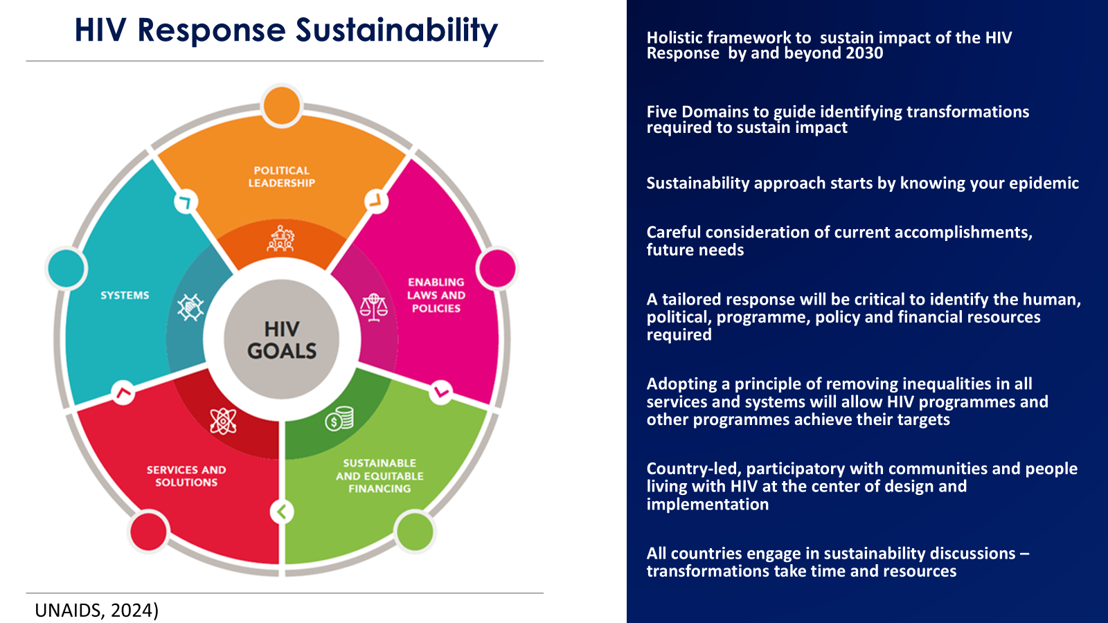
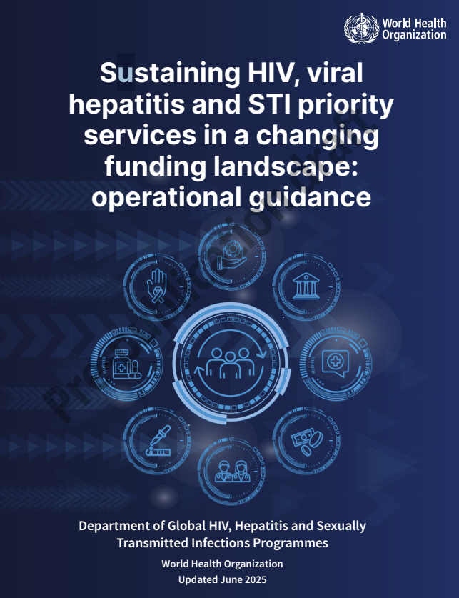
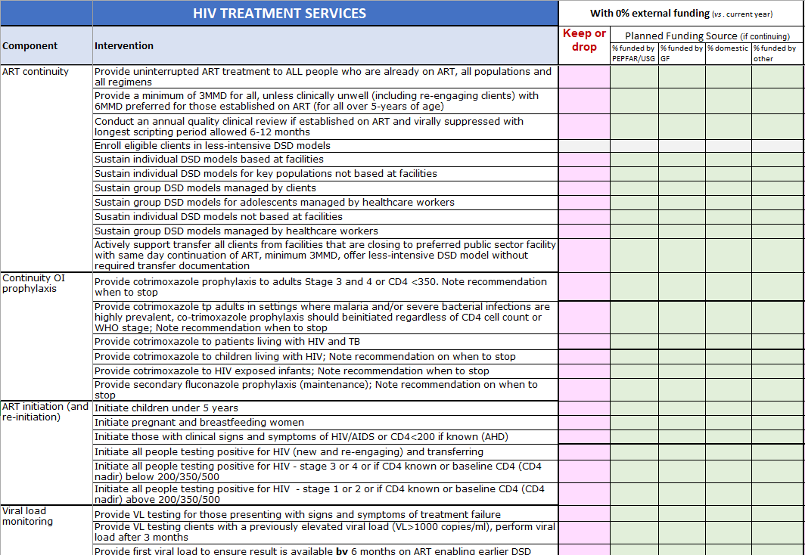
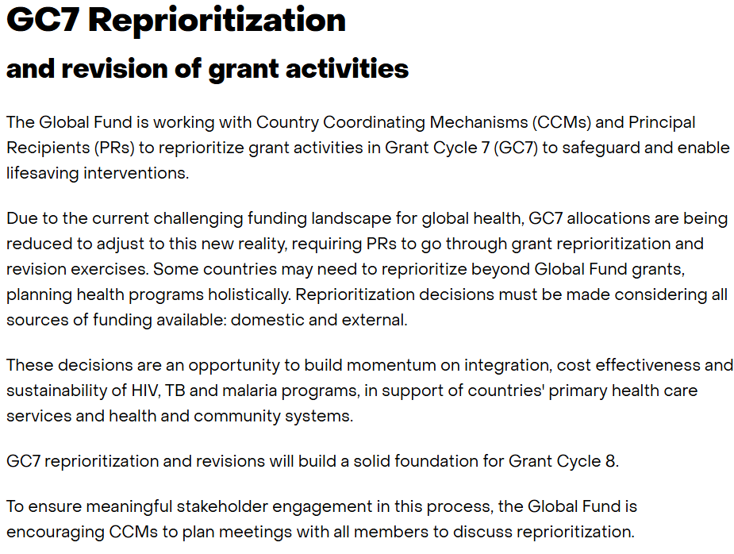

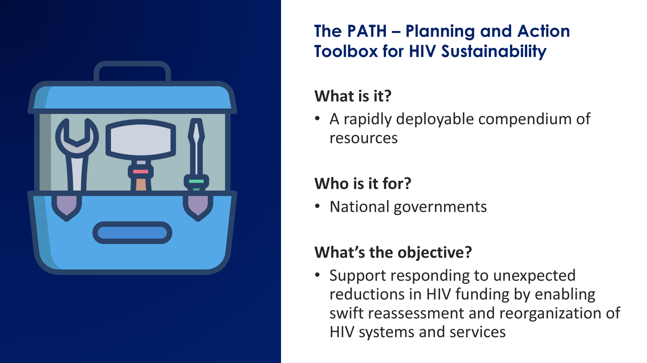
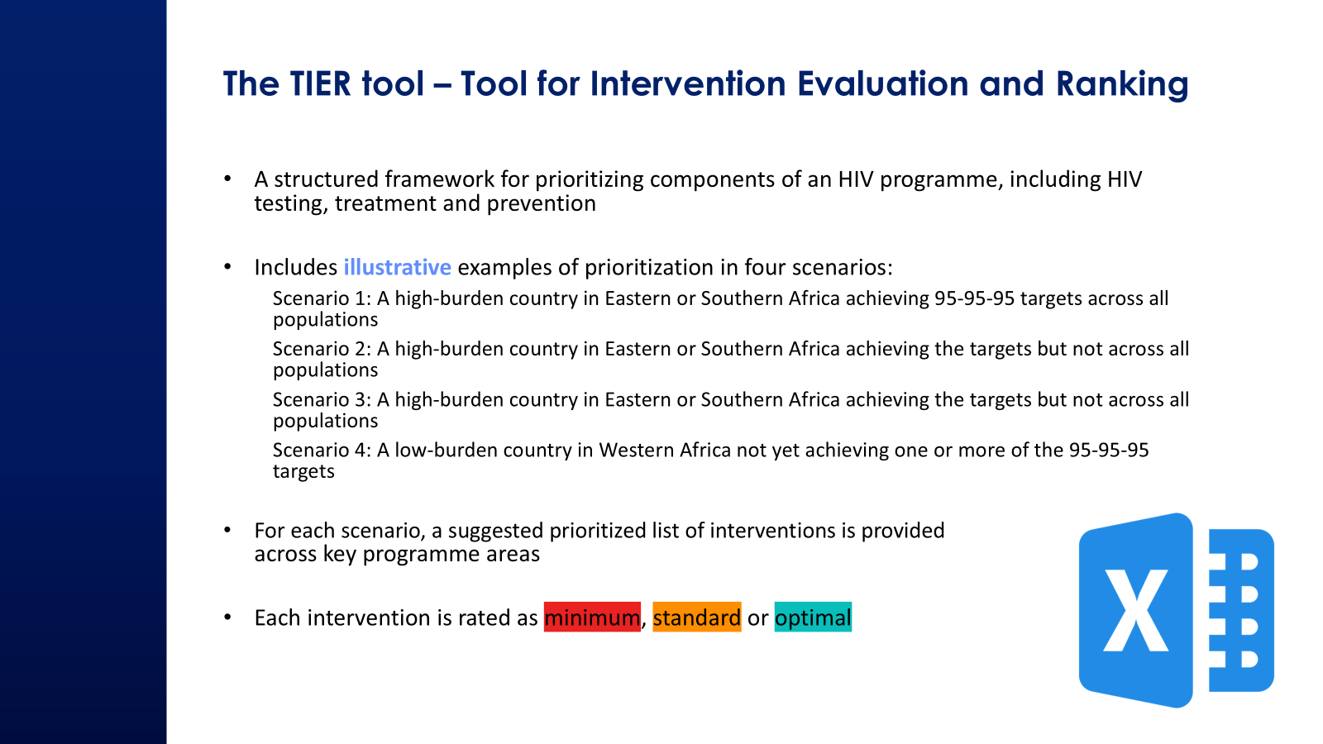
Global Tools to Support Country Response
UNAIDS Resources
WHO operational guidance
CQUIN Modified TIER Tool
Global Fund Reprioritization
The PATHS:
The Planning and Action Toolbox for HIV Sustainability
The IAS TIER tool:
Tool for Intervention Evaluation and Ranking
Notes:
From June–September 2025, member countries conducted HIV service-prioritization exercises using the following global resources:
UNAIDS Resources:
UNAIDS Sustainability Road Map
UNAIDS Rapid AIDS Response Financing Tool (RAFT)
WHO operational guidance- Sustaining HIV, viral hepatitis and STI priority services in a changing funding landscape: operational guidance
The PATHS: The Planning and Action Toolbox for HIV Sustainability
The IAS TIER tool: Tool for Intervention Evaluation and Ranking
CQUIN TIER & M&E indicator tools
Global Fund (GC7) reprioritization
These references provided a common, evidence-based frame to compare options across countries and funding scenarios.

Slide 3
HIV Service Prioritization
July-September 2025: Initial Scenario Planning Summary
Use of scenario-based external funding planning to enable rapid evidence-informed adjustments to HIV services and indicators, in response to evolving external funding realities.
16 out of 21 countries submitted outcomes by end of September 2025
Most countries (14 each) completed both low (0%) and moderate (≥50%) funding scenarios
Summary in CQUIN Website Sept Webinar
October-November 2025: Current Prioritization Revisions
Countries reviewed the ≥50% external funding scenario as most aligned with bridge funding levels received by most network countries to update status.
All 21 countries submitted prioritization outcomes
Each HIV service intervention was categorized using a standardized coding system:
Keep (No Change): Service will continue as currently implemented
Keep (Modify): Service will be adapted to reflect contextual shifts (e.g., sub-population, geography)
Drop: Intervention removed from the prioritized package
Not applicable: Intervention deemed irrelevant or non-operational in country context
Missing Data: Intervention not defined, described, or completed in submission

Slide 4
HIV Prevention
300% | Keep (No Change)
200% | Keep (Modify)
100% | Drop
9900% | Not applicable
 | Missing Data
By Country: Jul-Sep 2025 (N=14)
By Country: Oct-Nov 2025 (N=21)
Intervention | BUR | CAM | ESW | ETH | GHA | KEN | LES | LIB | MOZ | NIG | SEN | SL | TZ | UG
Infant PNP HR 0–6w
Infant PNP HR 6–12w
Infant PNP LR
Facility PEP (guidelines)
Community PEP (GBV/KP)
Facility condoms/lube
KP condom points
Community condom points
Facility PrEP KP 3MMD/6m
Facility PrEP PBFW 3MMD/6m
Facility PrEP others 3MMD/6m
Annual PrEP review
PrEP review 6-monthly
Facility PrEP DSD-indiv
Out-facility PrEP DSD
Virtual PrEP refills
Adherence/risk counselling
Continue DVR PrEP
Continue LAI PrEP
Start PrEP PBFW self-ID
Start PrEP PBFW at-risk
Start PrEP KP
Start PrEP AGYW self-ID
Start PrEP others self-ID
Test post-start 1–3m
PrEP demand creation
Continue DVR PrEP
Continue LAI PrEP
PrEP start education
Facility-first NSP+naloxone
Community NSP+naloxone
Continue OAMT refills (PWID)
Initiate/continue OAMT (PWID)
Targeted VMMC scale-up
Intervention | BUR | CAM | CIV | DRC | ESW | ETH | GHA | KEN | LES | LIB | MAL | MOZ | NIG | RWA | SEN | SL | SA | TZ | UG | ZAM | ZIM
Infant PNP HR 0–6w | 3 | 3 | 3 | 3 | 3 | 3 | 3 | 3 | 3 | 3 | 3 | 3 | 99 | 3 | 99 | 3 | 3 | 3 | 99 | 3 | 3
Infant PNP HR 6–12w | 2 | 3 | 3 | 99 | 3 | 3 | ### | 3 | ### | 99 | 3 |  | 99 | 3 | 3 | 3 | 3 | 3 | 3 | 3 | 3
Infant PNP LR | 2 | 3 | 3 | 99 | 2 | 1 | ### | 3 | ### | 99 | 3 |  | 99 | 99 | 99 | 3 | 3 | 3 | 3 | 3 | 3
Facility PEP (guidelines) | 3 | 3 | 3 | 3 | 3 | 3 | ### | 2 | ### | 3 | 3 | 3 | 3 | 3 | 3 | 3 | 3 | 3 | 3 | 3 | 3
Community PEP (GBV/KP) | 99 | 3 | 99 | 99 | 2 | 3 | ### | 3 | ### | 99 | 99 | 99 | 1 | 3 | 99 | 3 | 3 | 99 | 2 | 2 | 3
Facility condoms/lube | 3 | 1 | 3 | 3 | 3 | 3 | ### | 3 | ### | 3 | 2 | 3 | 3 | 3 | 3 | 3 | 3 | 2 | 2 | 3 | 2
KP condom points | 2 | 2 | 3 | 3 | 2 | 2 | ### | 3 | ### | 3 | 1 | 2 | 1 | 3 | 3 | 3 | 3 | 2 | 2 | 2 | 2
Community condom points | 2 | 2 | 99 | 2 | 2 | 1 | 1 | 3 | ### | 99 | 2 | 2 | 1 | 3 | 3 | 3 | 2 | 2 | 2 | 3 | 2
Facility PrEP KP 3MMD/6m | 99 | 2 | 2 | 2 | 2 | 2 | ### | 3 | ### | 2 | 3 | 3 | 3 | 3 | 3 | 3 | 3 | 3 | 1 | 2 | 3
Facility PrEP PBFW 3MMD/6m | 2 | 99 | 2 | 2 | 3 | 3 | ### | 99 | ### | 99 | 3 | 3 | 3 | 3 | 99 | 3 | 3 | 3 | 3 | 2 | 3
Facility PrEP others 3MMD/6m | 2 | 99 | 3 | 99 | 2 | 1 | ### | 3 | ### | 99 | 3 | 1 | 1 | 3 | 3 | 2 | 2 | 99 | 1 | 2 | 3
Annual PrEP review | 2 | 2 | 99 | 99 | 3 | 2 | ### | 99 | ### | 2 | 3 | 99 | 99 | 3 | 3 | 2 | #### | 3 | 3 | 2 | 3
PrEP review 6-monthly | 1 | 2 | 2 | 3 | 2 | 3 | ### | 3 | ### | 2 | 3 | 3 | 99 | 99 | 3 | 1 | 2 | 99 | 1 | 2 | 1
Facility PrEP DSD-indiv | 2 | 99 | 99 | 3 | 2 | 3 | ### | 3 | ### | 99 | 3 | 3 | 99 | 3 | 3 | 3 | 2 | 99 | 2 | 3 | 2
Out-facility PrEP DSD | 99 | 2 | 99 | 99 | 2 | 1 | 1 | 3 | ### | 99 | 3 | 1 | 3 | 99 | 3 | 3 | 2 | 99 | 3 | 2 | 99
Virtual PrEP refills | 99 | 99 | 99 | 99 | 99 | 1 | ### | 99 | ### | 99 | 99 | 99 | 1 | 99 | 99 | 99 | 2 | 99 | 2 | 99 | 99
Adherence/risk counselling | 3 | 3 | 3 | 3 | 2 | 3 | ### | 3 | ### | 3 | 3 | 3 | 3 | 3 | 3 | 3 | 2 | 3 | 1 | 3 | 3
Continue DVR PrEP | 99 | 99 | 99 | 3 | 2 | 99 | ### | 3 | ### | 99 | 99 | 1 | 99 | 99 | 99 | 2 | 2 | 99 | 2 | 1 | 3
Continue LAI PrEP | 99 | 99 | 99 | 99 | 2 | 3 | ### | 3 | ### | 99 | 3 | 99 | 3 | 3 | 99 | 2 | 2 | 99 | 3 | 2 | 3
Start PrEP PBFW self-ID | 99 | 99 | 2 | 99 | 3 | 3 | ### | 3 | ### | 2 | 3 | 2 | 99 | 3 | 99 | 3 | 3 | 3 | 3 | 3 | 3
Start PrEP PBFW at-risk | 3 | 99 | 2 | 2 | 3 | 3 | ### | 3 | ### | 2 | 3 | 3 | 99 | 3 | 99 | 3 | 2 | 3 | 3 | 3 | 3
Start PrEP KP | 2 | 3 | 3 | 2 | 2 | 3 | ### | 3 | ### | 3 | 2 | 2 | 3 | 3 | 3 | 3 | 3 | 3 | 3 | 2 | 3
Start PrEP AGYW self-ID | 99 | 99 | 2 | 2 | 2 | 99 | ### | 3 | ### | 99 | 2 | 2 | 3 | 3 | 99 | ### | 2 | 99 | 1 | 3 | 3
Start PrEP others self-ID | 99 | 99 | 2 | 99 | 3 | 1 | ### | 99 | ### | 99 | 3 | 2 | 2 | 3 | 99 | ### | 2 | 99 | 99 | 3 | 3
Test post-start 1–3m | 3 | 3 | 2 | 2 | 3 | 3 | ### | 3 | ### | 3 | 3 | 2 | 3 | 3 | 3 | ### | 2 | 99 | 3 | 3 | 3
PrEP demand creation | 2 | 3 | 3 | 2 | 2 | 3 | ### | 99 | ### | 3 | 3 | 2 | 2 | 3 | 3 | 3 | 2 | 3 | 2 | 2 | 2
Continue DVR PrEP | 99 | 99 | 99 | 99 | 2 | 99 | ### | 3 | ### | 99 | 99 | 3 | 99 | 99 | 99 | ### | 2 | 99 | 3 | 1 | 1
Continue LAI PrEP | 99 | 99 | 99 | 99 | 2 | 3 | ### | 3 | ### | 99 | 3 | 99 | 2 | 3 | 99 | ### | 2 | 99 | 2 | 2 | 3
PrEP start education | 3 | 3 | 99 | 2 | 2 | 3 | ### | 2 | ### | 3 | 3 | 3 | 3 | 3 | 3 | 3 | 3 | 3 | 3 | 3 | 3
Facility-first NSP+naloxone | 2 | 99 | 1 | 2 | 99 | 2 | ### | 3 | 99 | 99 | 99 | 2 | 1 | 99 | 3 | 3 | 3 | 3 | 1 | 2 | 99
Community NSP+naloxone | 2 | 99 | 1 | 2 | 99 | 2 | ### | 99 | 99 | 99 | 99 | 2 | 1 | 99 | 99 | 3 | 3 | 3 | 1 | 2 | 99
Continue OAMT refills (PWID) | 3 | 99 | 2 | 2 | 99 | 3 | ### | 3 | 99 | 99 | 99 | 2 | 3 | 99 | 3 | 2 | 3 | 3 | 3 | 2 | 99
Initiate/continue OAMT (PWID) | 2 | 99 | 2 | 2 | 99 | 3 | ### | 1 | 99 | 99 | 99 | 2 | 3 | 99 | 3 | 2 | 2 | 3 | 3 | 2 | 99
Targeted VMMC scale-up |  | 99 | 99 | 2 | 2 | 3 | ### | 1 | ### | 99 | 99 | 2 | 99 | 3 | 99 | 99 | 2 | 3 | 2 | 3 | 3
Notes:
Expanded participation from 14 to 21 countries from July–September prioritization to October–November 2025 period.
Broader, more representative prioritization of HIV services across the network, which will enrich the discussions at the CQUIN meeting this week.

Slide 5
HIV Prevention – Changes Across Time
300% | Keep (No Change)
200% | Keep (Modify)
100% | Drop
9900% | Not applicable
 | Missing Data
By Country: Jul-Sep 2025 (N=14)
By Country: Oct-Nov 2025 (N=14)
Intervention | BUR | CAM | ESW | ETH | GHA | KEN | LES | LIB | MOZ | NIG | SEN | SL | TZ | UG
Infant PNP HR 0–6w
Infant PNP HR 6–12w
Infant PNP LR
Facility PEP (guidelines)
Community PEP (GBV/KP)
Facility condoms/lube
KP condom points
Community condom points
Facility PrEP KP 3MMD/6m
Facility PrEP PBFW 3MMD/6m
Facility PrEP others 3MMD/6m
Annual PrEP review
PrEP review 6-monthly
Facility PrEP DSD-indiv
Out-facility PrEP DSD
Virtual PrEP refills
Adherence/risk counselling
Continue DVR PrEP
Continue LAI PrEP
Start PrEP PBFW self-ID
Start PrEP PBFW at-risk
Start PrEP KP
Start PrEP AGYW self-ID
Start PrEP others self-ID
Test post-start 1–3m
PrEP demand creation
Continue DVR PrEP
Continue LAI PrEP
PrEP start education
Facility-first NSP+naloxone
Community NSP+naloxone
Continue OAMT refills (PWID)
Initiate/continue OAMT (PWID)
Targeted VMMC scale-up
Intervention | BUR | CAM | ESW | ETH | GHA | KEN | LES | LIB | MOZ | NIG | SEN | SL | TZ | UG
Infant PNP HR 0–6w | 3 | 3 | 3 | 3 | 3 | 3 | 3 | 3 | 3 | 99 | 99 | 3 | 3 | 99
Infant PNP HR 6–12w | 2 | 3 | 3 | 3 | ### | 3 | ### | 99 |  | 99 | 3 | 3 | 3 | 3
Infant PNP LR | 2 | 3 | 2 | 1 | ### | 3 | ### | 99 |  | 99 | 99 | 3 | 3 | 3
Facility PEP (guidelines) | 3 | 3 | 3 | 3 | ### | 2 | ### | 3 | 3 | 3 | 3 | 3 | 3 | 3
Community PEP (GBV/KP) | 99 | 3 | 2 | 3 | ### | 3 | ### | 99 | 99 | 1 | 99 | 3 | 99 | 2
Facility condoms/lube | 3 | 1 | 3 | 3 | ### | 3 | ### | 3 | 3 | 3 | 3 | 3 | 2 | 2
KP condom points | 2 | 2 | 2 | 2 | ### | 3 | ### | 3 | 2 | 1 | 3 | 3 | 2 | 2
Community condom points | 2 | 2 | 2 | 1 | 1 | 3 | ### | 99 | 2 | 1 | 3 | 3 | 2 | 2
Facility PrEP KP 3MMD/6m | 99 | 2 | 2 | 2 | ### | 3 | ### | 2 | 3 | 3 | 3 | 3 | 3 | 1
Facility PrEP PBFW 3MMD/6m | 2 | 99 | 3 | 3 | ### | 99 | ### | 99 | 3 | 3 | 99 | 3 | 3 | 3
Facility PrEP others 3MMD/6m | 2 | 99 | 2 | 1 | ### | 3 | ### | 99 | 1 | 1 | 3 | 2 | 99 | 1
Annual PrEP review | 2 | 2 | 3 | 2 | ### | 99 | ### | 2 | 99 | 99 | 3 | 2 | 3 | 3
PrEP review 6-monthly | 1 | 2 | 2 | 3 | ### | 3 | ### | 2 | 3 | 99 | 3 | 1 | 99 | 1
Facility PrEP DSD-indiv | 2 | 99 | 2 | 3 | ### | 3 | ### | 99 | 3 | 99 | 3 | 3 | 99 | 2
Out-facility PrEP DSD | 99 | 2 | 2 | 1 | 1 | 3 | ### | 99 | 1 | 3 | 3 | 3 | 99 | 3
Virtual PrEP refills | 99 | 99 | 99 | 1 | ### | 99 | ### | 99 | 99 | 1 | 99 | 99 | 99 | 2
Adherence/risk counselling | 3 | 3 | 2 | 3 | ### | 3 | ### | 3 | 3 | 3 | 3 | 3 | 3 | 1
Continue DVR PrEP | 99 | 99 | 2 | 99 | ### | 3 | ### | 99 | 1 | 99 | 99 | 2 | 99 | 2
Continue LAI PrEP | 99 | 99 | 2 | 3 | ### | 3 | ### | 99 | 99 | 3 | 99 | 2 | 99 | 3
Start PrEP PBFW self-ID | 99 | 99 | 3 | 3 | ### | 3 | ### | 2 | 2 | 99 | 99 | 3 | 3 | 3
Start PrEP PBFW at-risk | 3 | 99 | 3 | 3 | ### | 3 | ### | 2 | 3 | 99 | 99 | 3 | 3 | 3
Start PrEP KP | 2 | 3 | 2 | 3 | ### | 3 | ### | 3 | 2 | 3 | 3 | 3 | 3 | 3
Start PrEP AGYW self-ID | 99 | 99 | 2 | 99 | ### | 3 | ### | 99 | 2 | 3 | 99 | ### | 99 | 1
Start PrEP others self-ID | 99 | 99 | 3 | 1 | ### | 99 | ### | 99 | 2 | 2 | 99 | ### | 99 | 99
Test post-start 1–3m | 3 | 3 | 3 | 3 | ### | 3 | ### | 3 | 2 | 3 | 3 | ### | 99 | 3
PrEP demand creation | 2 | 3 | 2 | 3 | ### | 99 | ### | 3 | 2 | 2 | 3 | 3 | 3 | 2
Continue DVR PrEP | 99 | 99 | 2 | 99 | ### | 3 | ### | 99 | 3 | 99 | 99 | ### | 99 | 3
Continue LAI PrEP | 99 | 99 | 2 | 3 | ### | 3 | ### | 99 | 99 | 2 | 99 | ### | 99 | 2
PrEP start education | 3 | 3 | 2 | 3 | ### | 2 | ### | 3 | 3 | 3 | 3 | 3 | 3 | 3
Facility-first NSP+naloxone | 2 | 99 | 99 | 2 | ### | 3 | 99 | 99 | 2 | 1 | 3 | 3 | 3 | 1
Community NSP+naloxone | 2 | 99 | 99 | 2 | ### | 99 | 99 | 99 | 2 | 1 | 99 | 3 | 3 | 1
Continue OAMT refills (PWID) | 3 | 99 | 99 | 3 | ### | 3 | 99 | 99 | 2 | 3 | 3 | 2 | 3 | 3
Initiate/continue OAMT (PWID) | 2 | 99 | 99 | 3 | ### | 1 | 99 | 99 | 2 | 3 | 3 | 2 | 3 | 3
Targeted VMMC scale-up |  | 99 | 2 | 3 | ### | 1 | ### | 99 | 2 | 99 | 99 | 99 | 3 | 2
Changes in Prevention Service Prioritization Across 14 Countries
(Jul–Sep vs Oct–Nov 2025)
14 interventions saw a decline in “Keep (No Change)” status, indicating reduced consensus on maintaining services as-is.
4 interventions saw a decline in “Keep (Modify)” status, suggesting fewer planned contextual adaptations.
A total of 33 interventions shifted away from active prioritization - either dropped or clarified as not applicable - highlighting a trend toward streamlining and contextual tailoring of HIV prevention interventions.
Notes:
Changes in Prevention Service Prioritization Across Network Countries – N=14 (Jul–Sep vs Oct–Nov 2025)
14 interventions saw a decline in “Keep (No Change)” status, indicating reduced consensus on maintaining services as-is.
4 interventions saw a decline in “Keep (Modify)” status, suggesting fewer planned contextual adaptations.
A total of 33 interventions shifted away from active prioritization - either dropped or clarified as not applicable - highlighting a trend toward streamlining and contextual tailoring of HIV prevention interventions.

Slide 6
HIV Prevention – Summative Findings
Sustained Emphasis on Infant Prophylaxis and PEP Facility-based infant prophylaxis (especially for high-risk infants in the first 6 weeks) and PEP remained high-priority across both periods. Emphasizing critical role in vertical transmission and post-exposure prevention.
PrEP Services Show Mixed Prioritization PrEP initiation and continuation for key populations and pregnant/breastfeeding women remained prioritized. Slight downgrading in October-November for virtual PrEP refills and out-of-facility DSD models.
Condom Distribution Deprioritized in Community Settings Community-based condom distribution (especially for general populations) saw a decline in prioritization in October-November. Facility-based condom availability remained more stable.
Harm Reduction for PWID Remains Low Priority Interventions like OAMT and needle/syringe distribution continued to have lower prioritization.

Slide 7
HIV Testing – Summative Findings
Facility-Based Testing Remains a Pillar Testing at ANC, TB, STI, and malnutrition clinics remained consistently prioritized. Testing for HIV-exposed infants and symptomatic individuals also remained prioritized across both periods.
Virtual and Community-Based HIVST Deprioritized Interventions involving virtual HIVST platforms and community-based HIVST collection points were deprioritized in October-November, suggesting a retreat from digital or decentralized testing modalities.
Partner Notification and Index Testing Maintained Provider-assisted and passive partner notification approaches remained prioritized, especially for newly diagnosed people with HIV and key populations.

Slide 8
HIV Treatment – Summative Findings
ART Continuity and Initiation - Universally Prioritized Uninterrupted ART, initiation for all populations (including children, pregnant women, and those with AHD), and viral load monitoring for treatment failure remained top priorities across both periods.
DSD Models - Mixed Support Facility-based individual DSD models retained high prioritization, but group models and out-of-facility options showed more variability and some deprioritization in October-November.
OI Prophylaxis and AHD Package - Gaining Cotrimoxazole and fluconazole prophylaxis, CD4 testing, and LAM/CRAG testing for AHD clients remained moderately prioritized.
Integration of NCD and FP Services - ? Work in Progress Interventions like cervical cancer screening, hypertension/diabetes management, and FP integration showed continued variability, with limited prioritization.

Slide 9
Overall Summative Findings
High Continuity in Core Interventions HIV services such as ART continuity, infant prophylaxis (0–6 weeks), TB testing and treatment, and HIV testing for symptomatic individuals remain consistently prioritized (“Keep (No Change)” across most countries).
Selective Deprioritization and Refinement Several interventions saw a shift from “Keep” to “Drop” or “Not Applicable” between July-September and October-November, particularly: Community-based services (e.g., community condom distribution, virtual PrEP refills).
Notes:
Greater Differentiation Across Countries While some interventions remained universally prioritized, others showed increased variability in October-November prioritization. Suggests a shift toward more country-specific services rather than a one-size-fits-all approach.

Slide 10
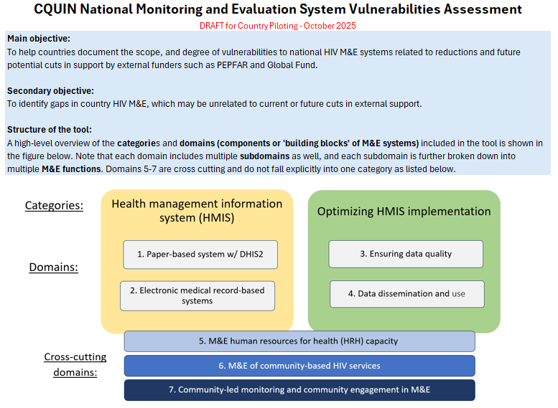
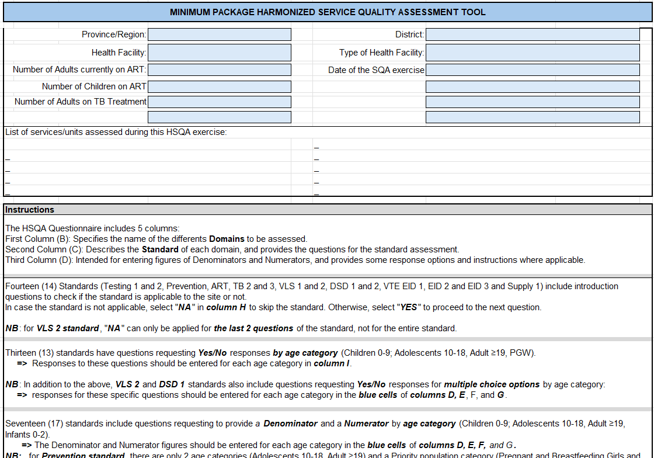
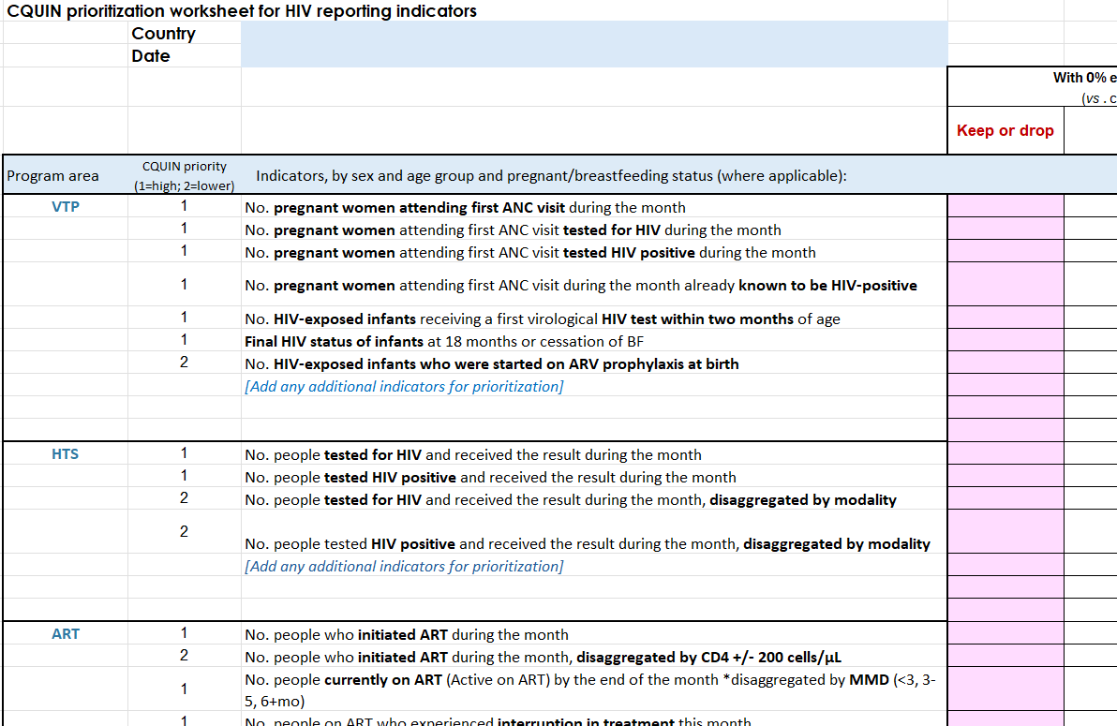
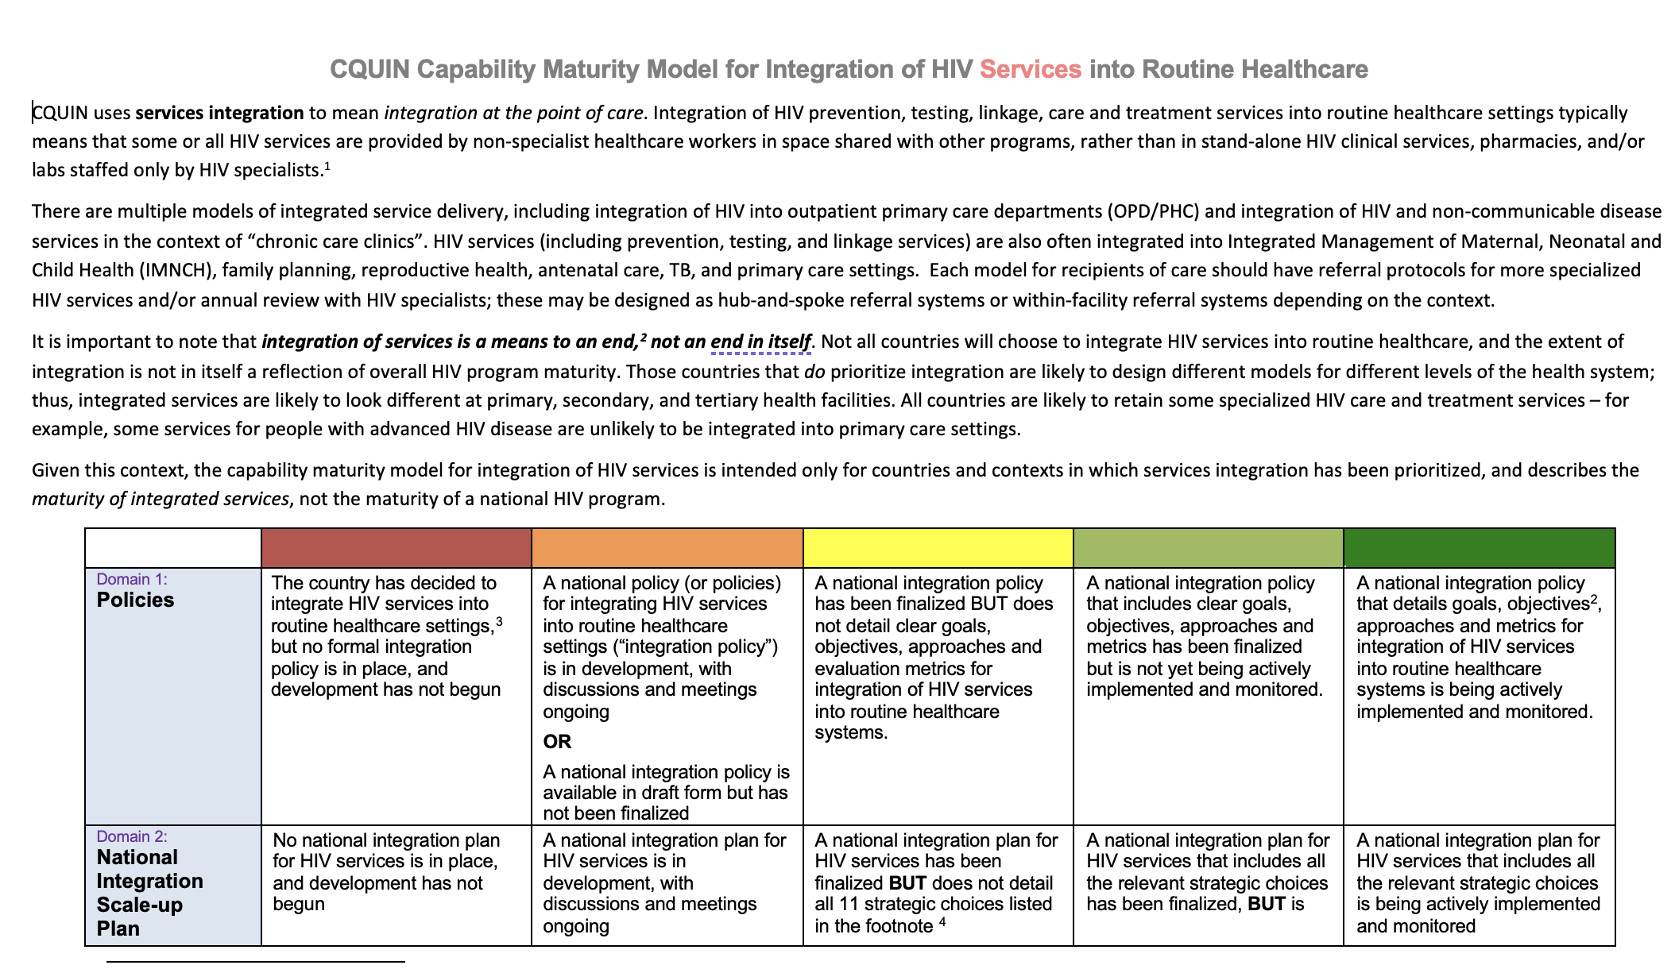
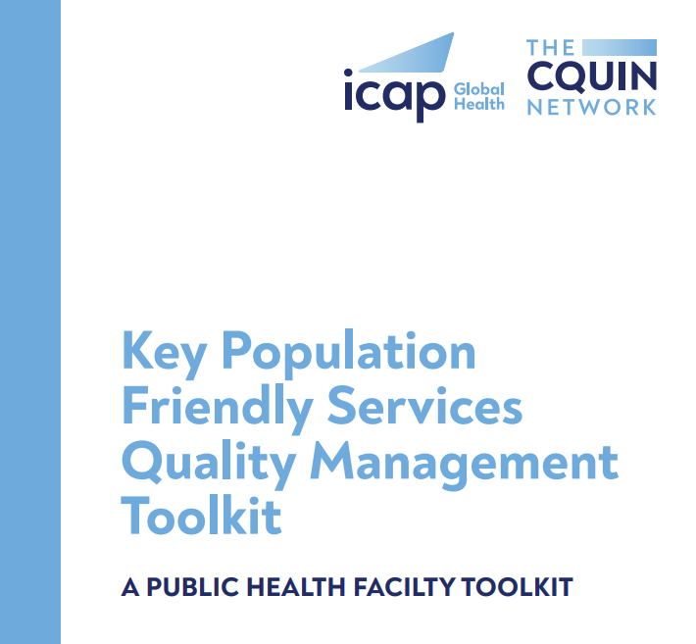
CQUIN Tools in Support of Country Response
The CQUIN National M&E System Vulnerabilities Assessment
HIV Program Minimum Package Service Quality Assessment Toolkit
CQUIN Modified TIER Tool
CQUIN M&E Indicator Prioritization Tool
CQUIN Services Integration CMM
Key Population Friendly Services Quality Management Toolkit

Slide 11


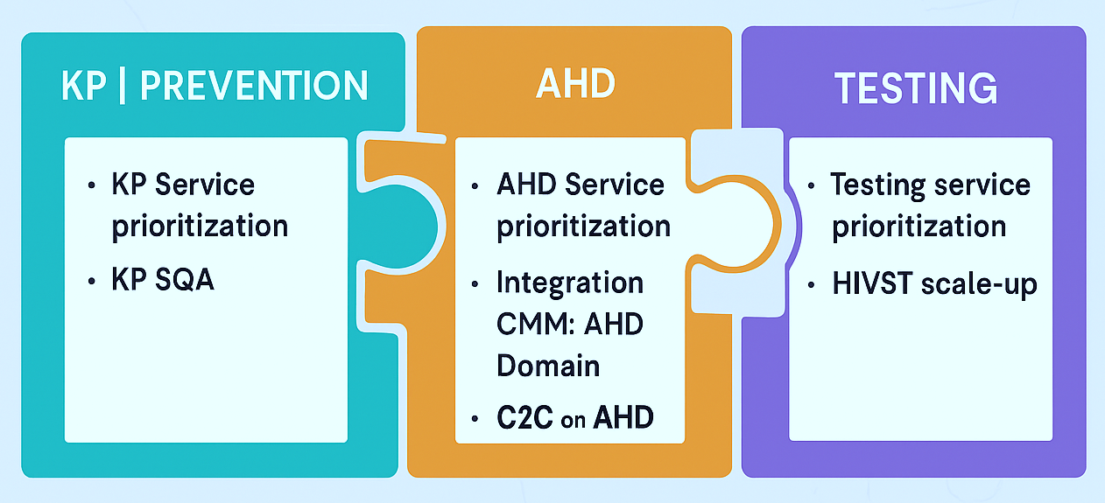
Additional CQUIN Cross Cutting Themes
Notes:
I will discuss a few, key Strategic Information items that have been in focus since we last met in June

Slide 12
Outline
Country HIV monitoring and evaluation (M&E) indicator prioritization
Country national health management information system (HMIS) data, 2024-25
Patterns suggesting program disruptions and impacts
CQUIN national M&E system vulnerabilities assessment
Notes:
This includes checking in on the national M&E indicator prioritization activity that countries completed following the June meeting;
Reviewing trends in key national HMIS data from CQUIN countries, which we promised to monitor for important impacts of funding cuts and disruptions;
And, introducing the draft CQUIN national M&E system vulnerabilities assessment, which has been piloted by several countries in recent weeks

Slide 13
Country priority HIV indicators
Notes:
When we last met in June, countries left with a request to prioritize HIV services and M&E indicators under a set of funding scenarios.

Slide 14
25 HIV indicators considered by CQUIN countries for prioritization
Program Area | Indicator
HIV testing services (HTS) | No. people tested for HIV and received the result
 | No. people tested HIV positive and received the result
 | No. people tested for HIV and received the result , by modality
 | No. people tested HIV positive and received the result , by modality
ART | No. people who initiated ART
 | No. people who initiated ART , disaggregated by CD4 +/- 200 cells/µL
 | No. people currently on ART - disaggregated by MMD (<3, 3-5, 6+mo)
 | No. people on ART who experienced interruption in treatment this month
 | No. people on ART who died this month
Viral load (VL) | No. VL results received
 | No. VL results <1000 copies/ml received
TB | No. people new on ART who were diagnosed with active TB
 | No. people new on ART who screened negative and initiated TPT
 | No. of people new on ART who completed TPT
HIV Prevention | No. people initiating PrEP
 | No. people receiving PrEP
 | No. people received post-exposure prophylaxis (PEP) this month
 | No. people received condoms this month (by HIV status)
Vertical transmission prevention (VTP) | No. pregnant women attending first ANC visit
 | No. pregnant women attending first ANC visit tested for HIV
 | No. pregnant women attending first ANC visit tested HIV positive
 | No. pregnant women attending first ANC visit already known to be HIV-positive
 | No. HIV-exposed infants receiving a first virological HIV test < 2 months of age
 | Final HIV status of infants at 18 months or cessation of BF
 | No. HIV-exposed infants who were started on ARV prophylaxis at birth
Notes:
Here is the list of 25 indicators countries were provided by CQUIN. Countries were asked to decide whether each of these should be kept, revised, or dropped in 2 funding scenarios: a 50% cut in external funding, and a complete cut to NO external funding

Slide 15
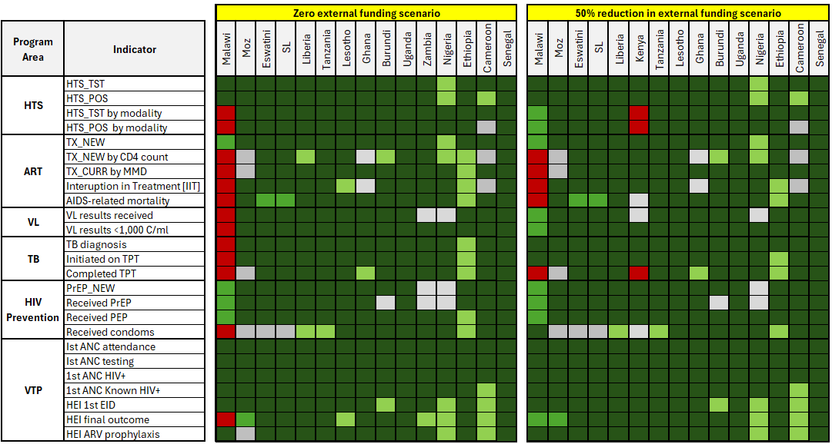
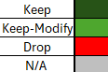
Indicator prioritization, by funding scenario and country
PEPFAR MOU
HIV services
indicators
PEPFAR MOU
pop-level HIV
indicators
95-95-95,
% of PBFW with HIV on ART
Notes:
Here is what 15 countries reported to us from their prioritization.
The indicators are listed down the left side, with most countries are listed across the top TWICE: once under the zero external funds scenario (on the left) and one under the 50% reduction scenario (on the right).
The cells here show the staging for each indicator: dark green indicating Keep; lighter green, Keep but modify; Red meaning DROP; and grey indicating N/A.
As you can see from the mass of green shading, overwhelmingly, countries envisioned keeping nearly all of these 25 indicators, even in the 0 external funding scenario. Only one country envisioned dropping significant numbers of indicators.
One entity that does appear to be dropping indicators is PEPFAR [click], at least based on the MOU guidance that has been unofficially circulated. Only three HIV services indicators (# tested HIV+, # current on ART, and # of HEI testing HIV+ by 18 mos) are included, along with several population-level indicators presumably to be assessed via surveys.

Slide 16
CQUIN-requested national HMIS indicators – Jan ’24 - current
PEPFAR MOU
HIV services
indicators
screened pos.
PEPFAR MOU
pop-level HIV
indicators
95-95-95,
% of PBFW with HIV on ART
Notes:
Now, shifting to the routine national HMIS indicators that were requested by CQUIN earlier this year, these indicators were mostly aligned with a subset of the 25 indicators listed here – you can seem them marked with a blue star here.
We are grateful that CQUIN country MOH teams have been so generous as to share much of this data with us.

Slide 17
Country national HMIS data, 2024-25
Notes:
Which I will summarize at a very high level here, with an eye towards assessing impacts of the program distruptions and funding cuts since January.
The data I will show here will not identify individual countries, but rather is intended to give an overview of key trends.
You can however see much of this data in country presentations and posters throughout the meeting this week

Slide 18
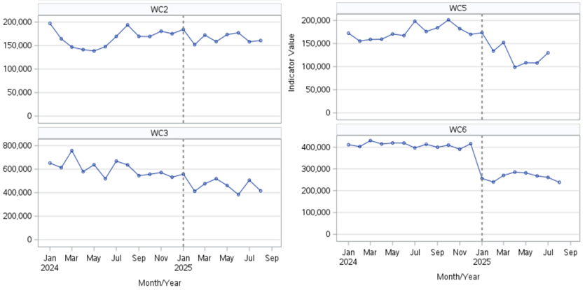
Example: Number of people tested for HIV, Jan 2024-Aug 2025 4 countries, Western/West-Central region
Two of the four countries reported clearly visible declines in HIV testing in 2025
Notes:
Here is an example of the type of data that has been shared, here from 4 countries in Western & Central Africa. This shows the number of people tested for HIV by month, from Jan 2024 through August 2025.
The dotted vertical line marks Jan 2025, when the first USG distruptions occurred.
We don’t see a clear change after Jan in all of the countries here; however certainly the two on the right (labeled as WC5 and WC6) do have obvious, large declines in testing.

Slide 19
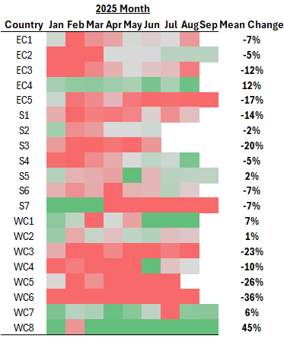
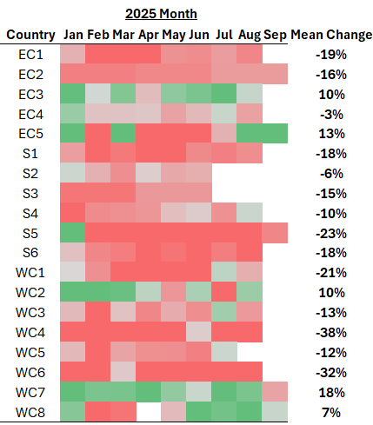
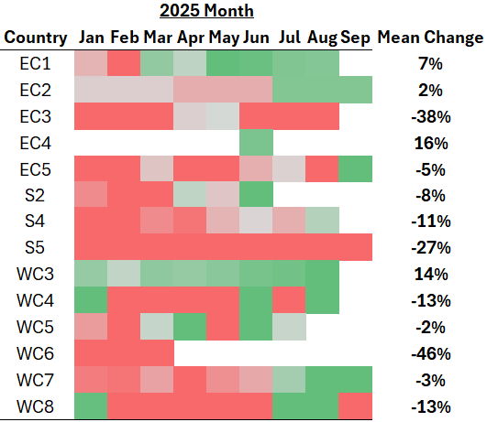
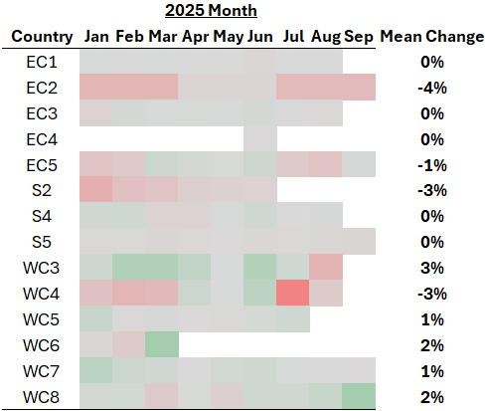
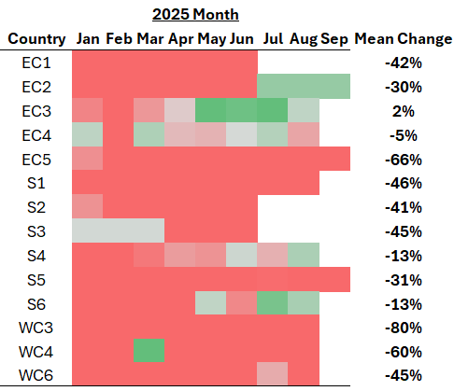
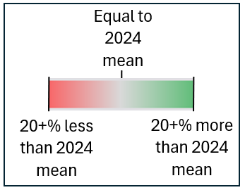
% change in HIV services: 2025 vs. overall 2024 monthly means, 19 countries = (monthly #) / (overall mean monthly #, 2024)
# receiving HIV testing
# new on ART
# received VL results
% with VL < 1000*
# new on PrEP
*Among people on ART with VL results
No clear change in % with VL>1000
>20% reductions in volume of HTS, ART initiations, VL testing, and PrEP initiations in many countries
Notes:
Now looking at this type of data a different way – here we see heat maps for 4 indicators that summarize the % change in the volume of HIV services reported by month is 2025 vs. the overall 2024 monthly average for the indicator, in 19 countries. As shown on the bottom-right, the colors highlight differences of 20% or more from the 2024 average, with red indicating a reduction. The Mean Change column shows the change in the overall average monthly number in 2025 vs. 2024. Countries are anonymized, and listed in the first column of each figure. [So for example [CLICK] this row shows the % change in the # receiving HIV testing in country EC1 during Jan-Aug 2025, as compared to the average monthly HIV testing in 2024. There was a large decline in February with tapered off by May and then declined again in August; with an overall average decline of 7% in 2025.]
Broadly, what we see here is a lot of red, throughout each of these four indicators: # tested, # new on ART. # received VL results, and # new on PrEP. In some cases, the declines are temporary; in particular with VL testing, there seems to be some bounceback in the latter months; but overall the declines persist to some degree through Aug-Sep. These could reflect gaps in data systems to an extent, as well as service disruptions. Less discouraging is the VL testing results [CLICK] which do NOT show a pattern of declines in the PROPORTION of people with a VL test results <1000.

Slide 20
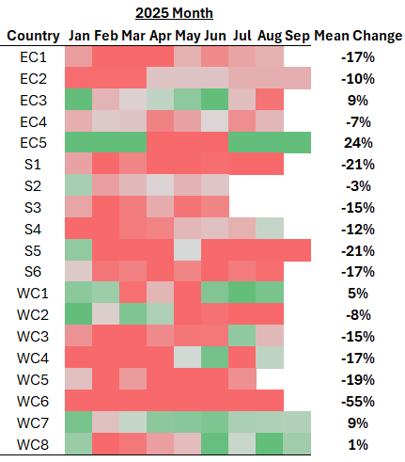
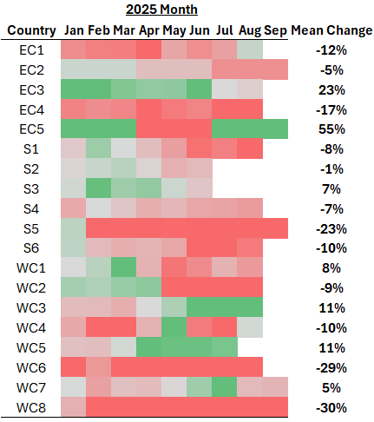
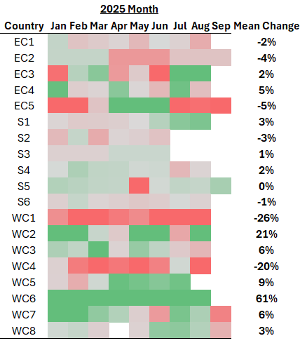
Unpacking reductions in # new on ART in 2025, 19 countries
# receiving HIV testing
# tested HIV+
# new on ART
Proxy % linkage to ART
% tested HIV+
Reductions generally due to reduced testing volume and reduced % positivity (i.e., not reduced linkage)
Notes:
I won’t get into all of the details here – but this slide summarizes the changes in the # tested, the % and # tested HIV+, # new on ART, and a calculated proxy % linkage to ART. A key point is that we are seeing declines in all of these indicators except [CLICK] proxy linkage. [CLICK] This suggests that reductions # new on ART are generally due to reduced testing volume and reduced % positivity and NOT reduced linkage, for example due to unavailability of ARVs

Slide 21
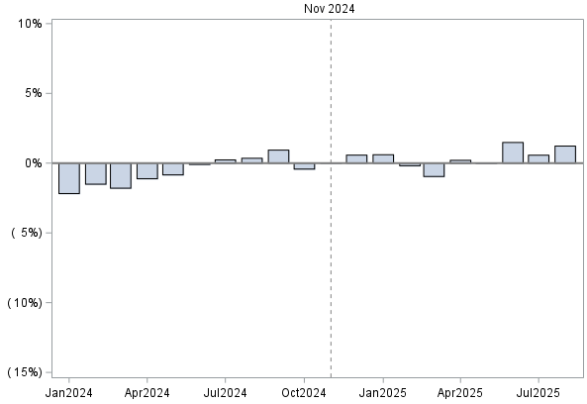
Trends in # current on ART Summarized as % difference from Nov 2024 # current on ART
November 2024
> Nov 2024
# current on ART
Suggests some degree of disruption in ART services and/or data systems
Expected # current on ART
Equal to # on ART in Nov 2024
< Nov 2024
# current on ART
2.) Less consistent but generally increasing # on ART from November 2024 to August 2025
1.) Mostly consistent increase in # on ART from January 2024
Month & Year
Notes:
The last analysis I want to share is looking at trends in the # current on ART. This shows an example of a trend in one country across 2024 and 2025. This is using the % differences between the monthly numbers and November 2024’s monthly number to express the trend.
[CLICK] What we see in 2024 is a mostly consistent increase in # on ART through December and into January. From that point [CLICK], during the current year, we see a less consistent but generally increasing # on ART. The red dotted line shows a rough expected trend into 2025. The results suggests perhaps some degree of disruption in ART services and/or data systems since January

Slide 22
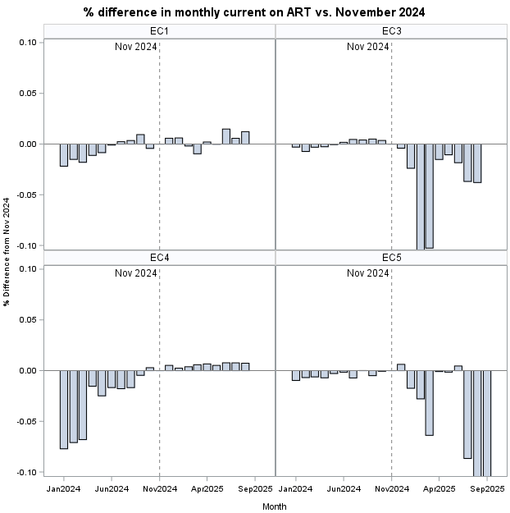
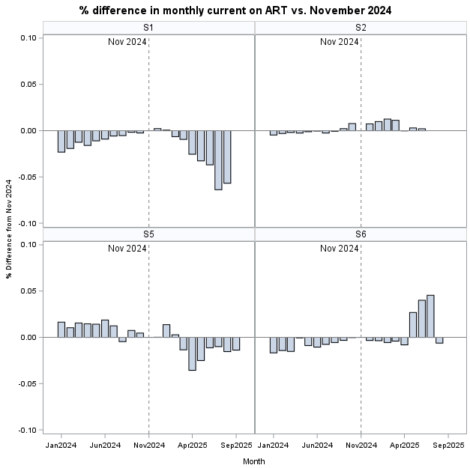
Trends in # current on ART, Jan 2024-Sep 2025 8 countries, Eastern and Southern Africa Shown as % difference from November 2024 # on ART
-10% -5% No change 5% 10%
-10% -5% No change 5% 10%
Declines in # current on ART in 3 countries, of 5-10% and in some cases even >20%
-10% -5% No change 5% 10%
-10% -5% No change 5% 10%
Notes:
Looking at this trend for 8 CQUIN countries in Eastern and Southern Africa – what jumps out [CLICK] is large shifts towards declines in # current on ART in 3 countries, of 5-10% and in some cases even 20% or more. This pattern is not limited to the 3 countries shown here. Our CQUIN SI advisors have reached out to countries to share this data and discuss reasons for the shifts.

Slide 23
Interpretation of HMIS data
Large (>20%) reductions in HIV testing volume, ART initiations, VL testing, and PrEP initiations in many countries
Reductions in # new on ART generally due to reduced testing volume and reduced % positivity (i.e., not linkage to ART)
No clear pattern suggesting a decline in % of ROC with VL<1000, among ROC receiving VL testing
Several countries reported substantial drops in # current on ART in 2025 – potentially a critical priority
Notes:
In summary, the routine national M&E data shared by CQUIN countries shows Large (>20%) reductions in HIV testing volume, ART initiations, VL testing, & PrEP initiations in many countries. There does not seem to be a bottleneck at the point of ART initiation – declines in # new on ART are in line with reduced # testing HIV+. We did not see reductions in the % of people on ART with VL<1000, and lastly, we did see potentially alarming drops in the number of people currently receiving ART in a number of countries, which we are working with countries to better understand, but we wanted to flag here as well.

Slide 24
CQUIN M&E system vulnerabilities assessment
Notes:
Finally, I want to very briefly introduce an initiative that was kicked off recently, the CQUIN M&E system vulnerabilities assessment. This tool was inspired by our mostly anecdotal understanding of the large extent of donor support for M&E systems, and the seeming discordance with the M&E indicator prioritization I showed earlier—which showed countries expecting to KEEP nearly all indicators, even with ZERO external funding.

Slide 25
Objectives of assessment
Main objective:
To help countries document the scope, and degree of vulnerabilities in national HIV M&E systems related to potential cuts in support by external funders such as PEPFAR and Global Fund
Secondary objective:
To identify gaps in country HIV M&E systems, which may be unrelated to current or future cuts in external support
Notes:
The main objective of the assessment is to help countries document, at a granular level, the vulnerabilities in national HIV M&E systems related to potential cuts in support by external funders such as PEPFAR and Global Fund
A secondary objective is to, at the same time, identify existing gaps in country HIV M&E systems, which may be unrelated to current or future cuts in external support

Slide 26
M&E-related domains assessed Domains contain sub-domains (n=46) and M&E functions (n=199) for scoring
Health management information system (HMIS)
1. Paper-based system w/ DHIS2
2. Electronic medical record-based systems
Optimizing HMIS implementation
3. Ensuring data quality
4. Data dissemination and use
Categories:
Domains:
5. M&E human resources for health (HRH) capacity
Cross-cutting domains:
6. M&E of community-based HIV services
7. Community-led monitoring and community engagement in M&E
Notes:
The assessment is organized under 7 domains reflecting aspects of national M&E, as shown here; there are a total of 46 subdomains in total, and across all of these subdomains there are almost 200 (199) “M&E functions” that are assessed

Slide 27

Summaries of M&E vulnerability assessment pilot results: M&E function-level scores
Country B
Country A
Country C
Notes:
To go straight to the pilot data, this summarizes the vulnerability scores for 3 countries who piloted the tool in recent weeks. Specifically this shows the scores for the M&E functions across the subdomains, with blue indicating a gap in an M&E functions—that is, the country is not implementing this function at all—red indicating high vulnerability, meaning that the M&E function is entirely supported by external funds or TA; gold indicating partial vulnerability, that at least partial external funds or indirect support; and, in the rare case, green indicating that the M&E function is carried out independently by the government. You can see here that there are very few M&E functions carried out independently – [CLICK] . Further, Country A has extensive M&E gaps, which are not supported by donors or the government. Country B has fewer gaps, but vast segments of its M&E system are entirely supported by external donors. Country C has no gaps, and also no green at all; nearly all M&E functions are partially supported.
I will note that countries also reported whether external support was direct (funding or personnel), indirect (TA), for relevant M&E functions.

Slide 28
M&E system vulnerability assessment pilots – takeaways
All three countries showed partial or complete vulnerability, or gaps in M&E, in all domains assessed
The degree of reliance on external funders varied across countries
One country reported substantial M&E system gaps
This information may help countries prepare for discussions with donors, and plan for government-financed and led M&E functions where prioritized
More details on pilot results will be presented by countries in sessions 9 and 12.
Notes:
So a major takeaway here is that all three countries showed partial or complete vulnerability, or gaps in M&E, in all domains assessed.
Though, there were differences in the type and degree of vulnerability by country
We hope that this assessment helps countries plan for discussions with donors, and prioritize efforts to strengthen government-ownership of M&E of the national HIV response.
Lastly… for more details on the pilot assessments from 4 countries, please be sure to attend sessions 9 and 12, where countries will be presenting their data.

